Slide 1
TELUS ICIS partnership ICIS 10 years of data sharing Bill Hain member of the TELUS team Vancouver GIS Users Group October 12th, 2011
Notes:
Bill Hain TELUS Manager Technology Strategy – BC ICIS Board of Directors – Treasurer

Slide 2
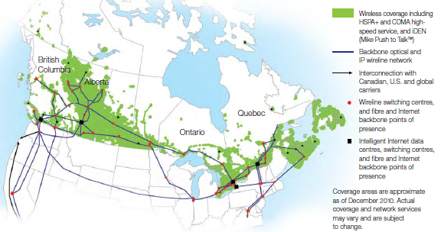
about TELUS
WHO WE ARE
TELUS is a leading national telecommunications company in Canada, with $9.8 billion of annual revenue
and 12.3 million customer connections including:
7.0 million wireless subscribers
3.7 million wireline network access lines
1.2 million Internet subscribers
400,000+ TELUS TV® customers.
TELUS provides a wide range of communications products and services including data, Internet protocol (IP), voice,
entertainment and video.
In support of our philosophy to give where we live, TELUS, our 36,000 team members plus retirees have contributed $211 million to charitable and not-for-profit organizations and volunteered 3.7 million hours to local communities since 2000.
Our 2011 TELUS Day of Service was May 28th
TELUS named ultimate supported of Tree Canada
Notes:
TELUS named ultimate supporter of Tree Canada
Tree Canada has honoured TELUS with its Ultimate Award, which recognizes partners that have contributed more than $1 million in support of the stewardship of trees. Tree Canada is a non-profit organization that encourages Canadians to plant and care for trees in rural and urban areas

Slide 3
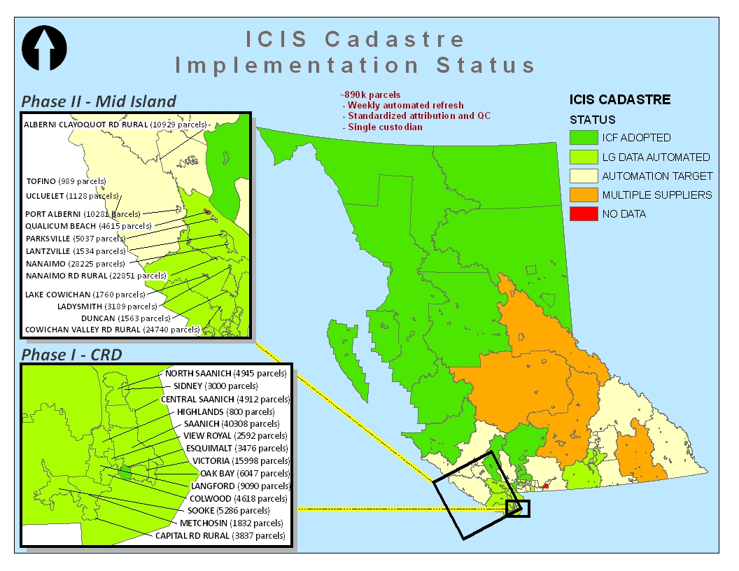
about ICIS
WHAT IS ICIS ?
Integrated Cadastral Information Society
ICIS is a non-governmental and non-profit organization that is supported entirely by its members.
ICIS facilitates collaborative solutions for the creation, integration and maintenance of province-wide spatial data from all levels of Government, First Nations, and utility companies in the province of BC.
890k land parcels – target completion 2013
Members:
Province of BC + 5 Ministries
184 local governments (all but 4)
22 First Nation members
6 utility members
18 associate members
4 affiliate members
ICIS products:
Web Map
BC Spatial
AddressBC
ICIS celebrated it’s 10th year in May 2011
Looking forward to another 10 years !
Notes:
4 non-signed local governments – Vancouver, Chilliwack, Qualicum, Wells.
22 First Nations members represent over 50 bands.
6 utility companies – BC Hydro, FortisBC, Kinder Morgan, Shaw, Spectra Energy, TELUS
18 Associate Members: Agriculture Canada, Department of National Defence, RCMP; Pacific Northern Gas; Vancouver Fraser Port Authority; Teck Coal Limited; Vancouver Island Health Authority; and private surveying companies
4 affiliate members – Fire Chief’s Association, First Nations Technology Council, Government Finance Officers Association, Local Governement Management Association
Membership is entirely voluntary, there are no "sticks" such as legislative or regulatory requirements to force companies to participate and share their data. The benefits of having access a shared database of utility and cadastral geospatial data for the entire province appears to be the primary motivation for participation. ICIS is a data aggregator and does not make changes to content. It does provide grants to local governments to help them improve the quality of their data and will pass on errors detected and reported by users to the appropriate data custodian.
Annual operating budget $1.2M

Slide 4
Benefits of ICIS partnership to TELUS
our experience
TELUS joined ICIS as a founding partner
TELUS has provided almost $2M to ICIS over the 10 year period
In 2001 there was no source for common land base in BC
TELUS / BCTEL has been participating in data sharing initiatives with other utilities and local governments since 1985.
We did not want to have 188+ separate agreements for electronic access and data sharing
Believe in a better method of sharing information and working with local governments – the future is friendly
We want a seat at the table
Other ICIS partners represent several of our largest customers
Competition – Company Evolution – Brand Awareness
One source for our land base mapping information
Up to date accurate property data
TELUS provides non-proprietary structure & cable information to ICIS
TELUS supports BC One Call and the protection of our underground facilities for the safety and network reliability of our customers.
our logic
our benefits

Slide 5
Challenges of ICIS partnership to TELUS
our data
Exporting data out of legacy GIS system
Method of data delivery
4 separate land sources for BC data
Projections: UTM10 /11/12 → Lambert Conic NAD27 → NAD83
Line and symbol tables
Attributes
Determine what we are legally allowed to share
our participation
13 years of meetings / loss of focus / disputes between province & muni’s
lack of trust – someone is getting away with something
Protectionism, ownership, legality, security
Degree of accuracy: +/- 1m , +/- 10m, side of street accuracy, picnic table in a park
Standards
Dependency on other utility partners for funding
Return on Investment – tough business case to justify
Provincial government change in direction / policy / philosophy
ultimate challenge
alignment

Slide 6
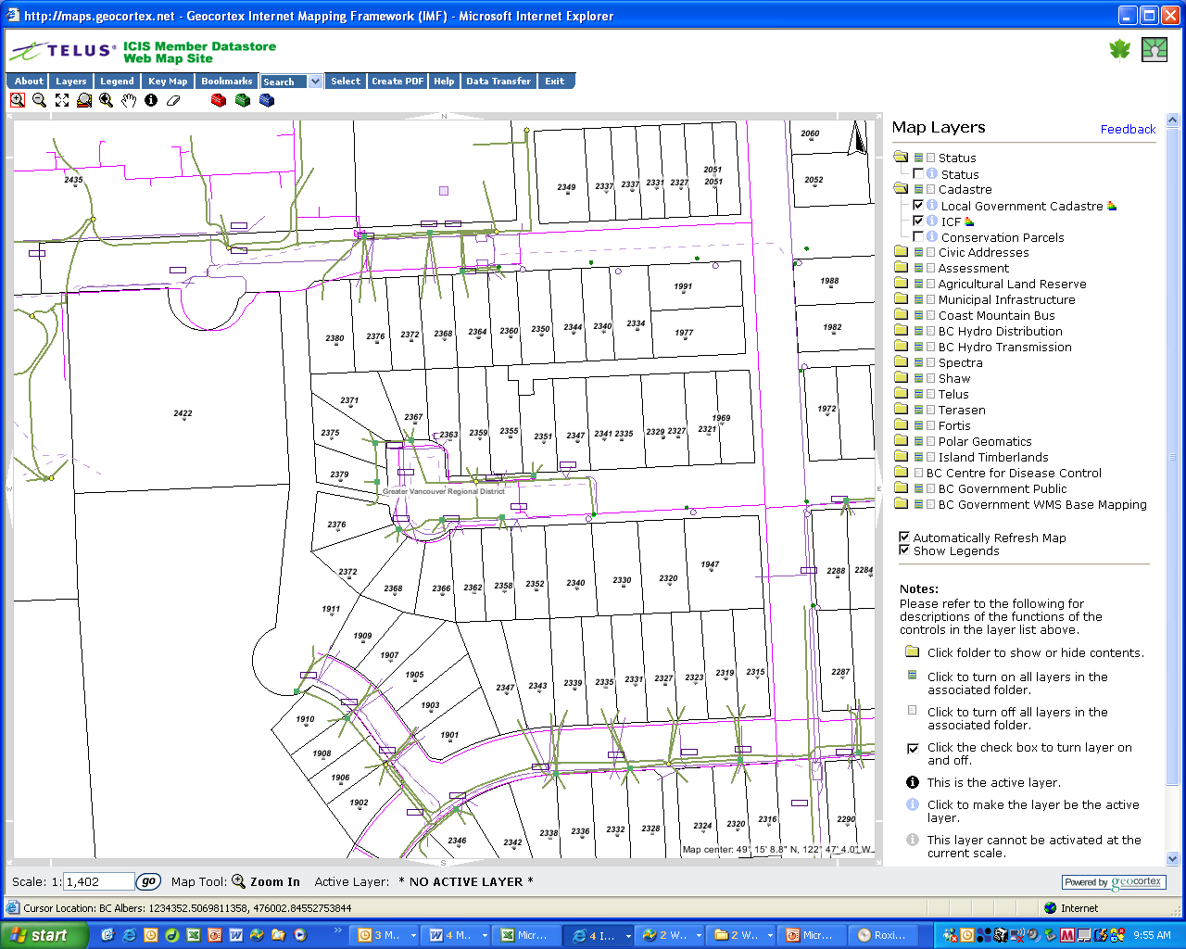
alignment
Notes:
TELUS is closely following FortisBC and their re-alignment project.
Data which was good enough for 2003 is insufficient for 2011 and moving forward.

Slide 7
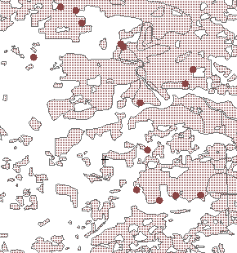
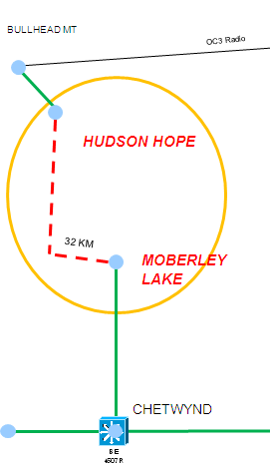
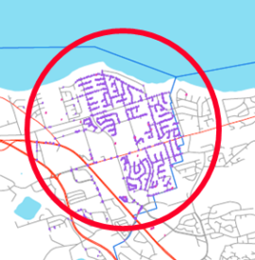
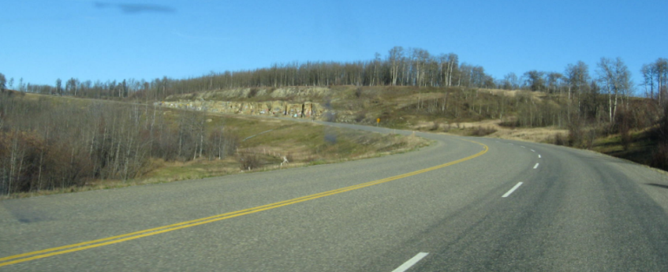
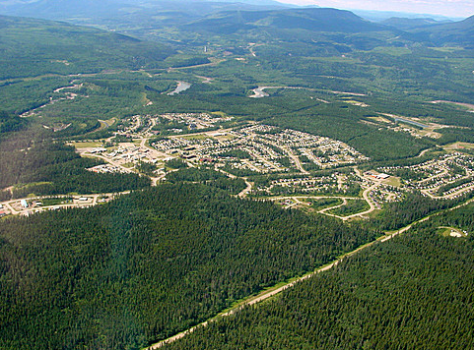
Tangible benefits of ICIS partnership to TELUS
enable
e.locate – bc one call
e.permit – electronic permit application
enjp – electronic network job package
design on line
joint venture – electronic pole management with BC Hydro
real project
mountain pine beetle hazard trees
locate, assessment, permission, removal
remote locations
pipeline proposals, mine sites, remote communities
Go BC, Connecting Communities, HSIA expansion, feasibility studies

Slide 8
TELUS & ICIS potential for the next 10 years
build on FortisBC experience with data re-alignment
evolve to next generation TELUS GIS
integrate AddressBC with TELUS Addressing for service delivery & 911
continuous improvement on data accuracy
evolution of TELUS networks – GPON, 4G, HSPA, femtocell
$1B investment in the province of BC over next 10 years
TELUS data
Ease of data delivery and management
Integration with web base mapping tools (mainstream)
Extension of land base data
Rights of Way and land use permits
Environmental
Tower data – not just TELUS
Air rights
Protection of air / space / view corridors
Sub-surface inventory
Special interest partners
VAR – value add resellers and Service delivery providers
New revenue streams
ICIS data and services
ICIS is the ONLY successful collaborative society of it’s type in the world
Notes:
FortisBC – Piet Nooij - December 7th presentation to the Vancouver GIS Users Group
ICIS started with a single purpose – Common Good and the conviction that together we could all be better – more efficient, higher quality, and quicker access to information.
In the 10 years – introduction of Google Earth, tweets, “follow us on the web” have evolved

Slide 9
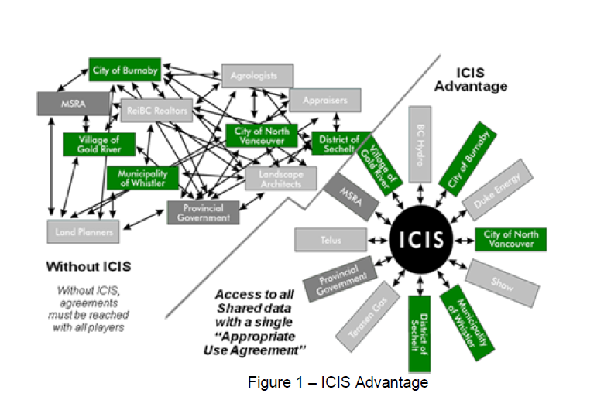
ICIS advantage
Notes:
Amazing that ICIS has survived and succeeded.
ICIS is the ONLY successful collaborative society of it’s type in the world.
TELUS is proud to be a partner in this success.
The future is friendly.

Slide 10
thank you questions

